Slide 1
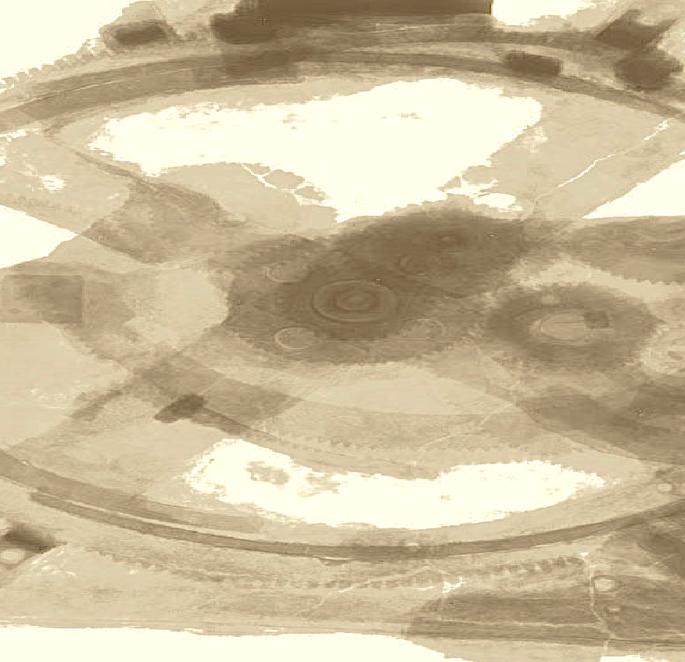

Drops of LTSpice
Adding new components in LTSpice

Slide 2
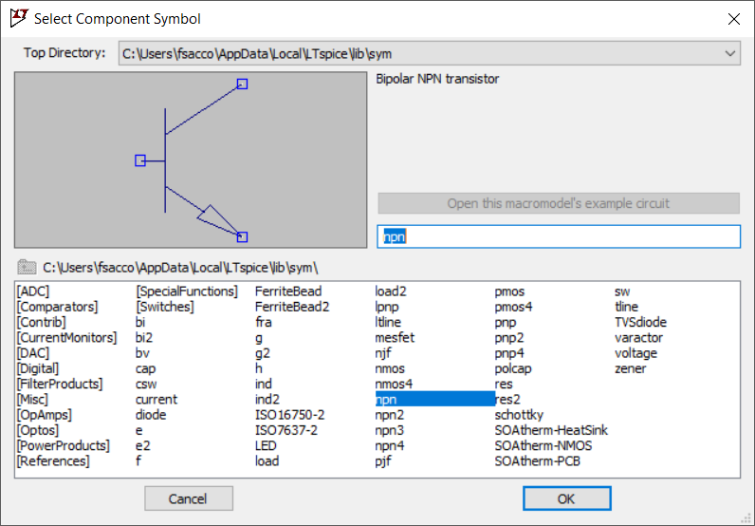
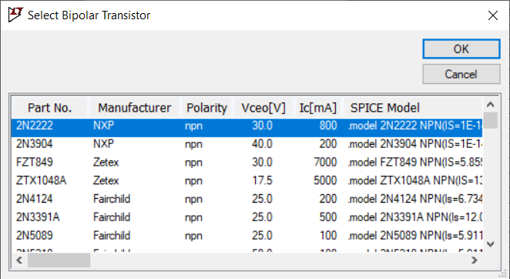
If you've ever chosen a transistor on LTSpice…
…you know that there is a limited set of options.

Slide 3
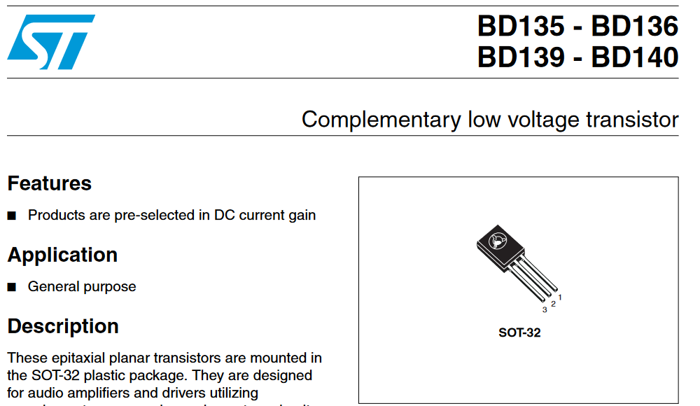
I like to use BD139 in my project, but LTSpice doesn't have this model.
Right?

Slide 4
Yes, you can add new components to your LTSpice.
The secret is here.

Slide 5
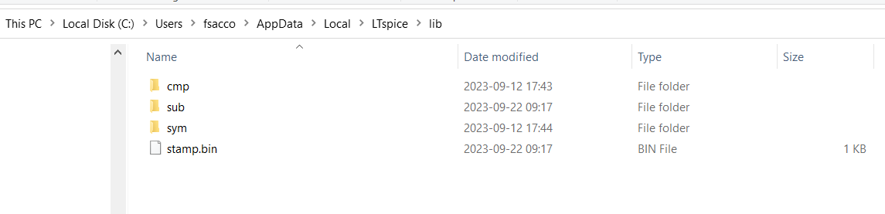
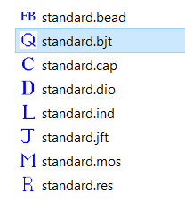
The CMP directory contains the component templates.
And the file extension indicates what type of component it is.
Our BD139 is a BJT, so this is our file.

Slide 6
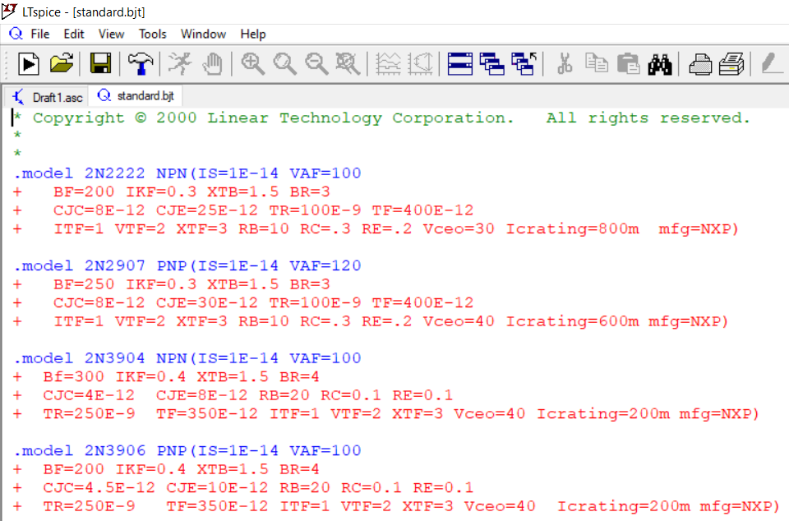
You can open the file in LTSpice.
You can already see that .model indicates a component.

Slide 7
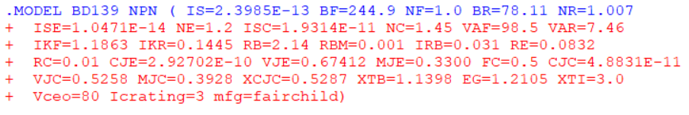
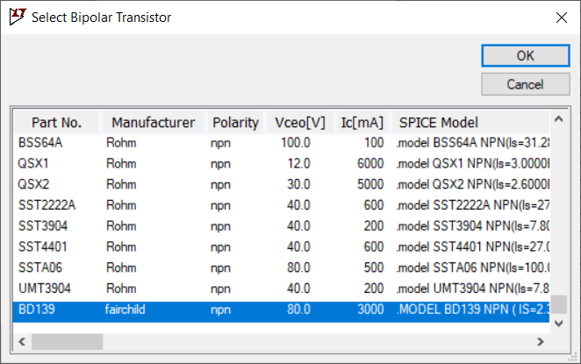
Once we added our BD139...
…the component will be there.

Slide 8
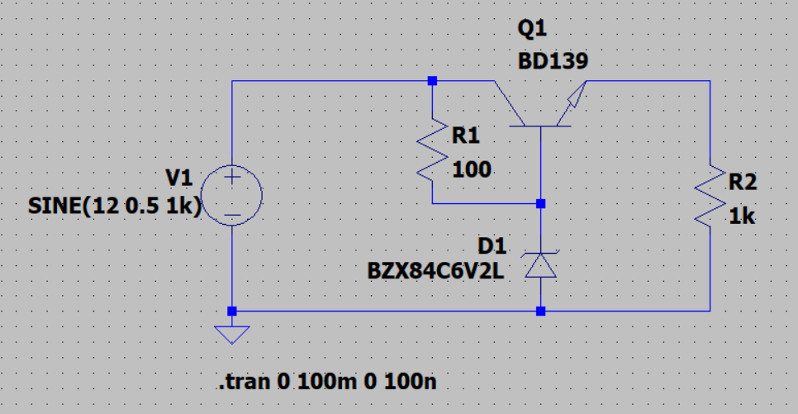
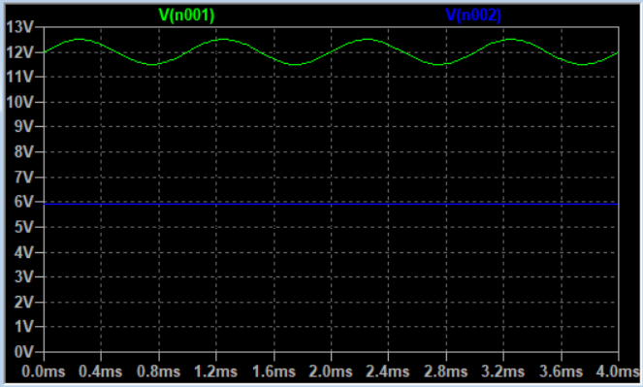
And it works!

Slide 9
But you might be wondering:
Where did you get the model data for the BD139?
And this is the most important information!

Slide 10
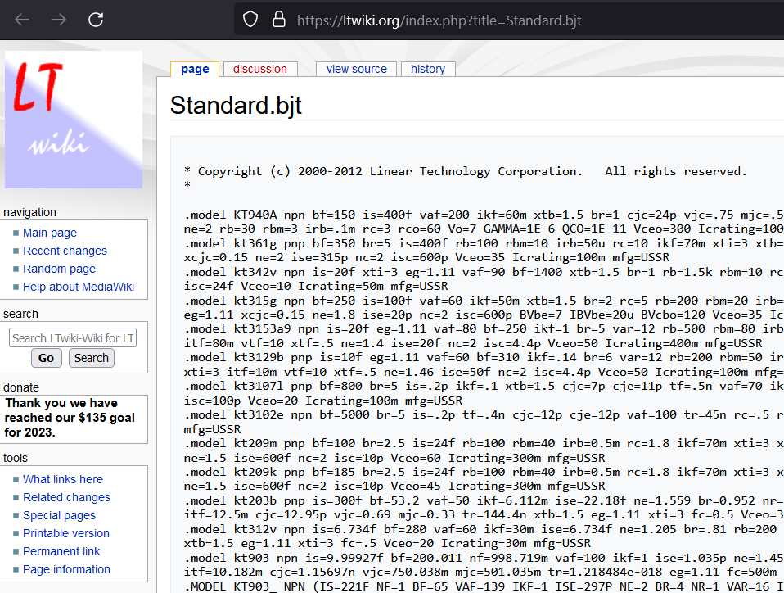
LTSpice has a very collaborative community.
http://www.ltwiki.org/

Slide 11
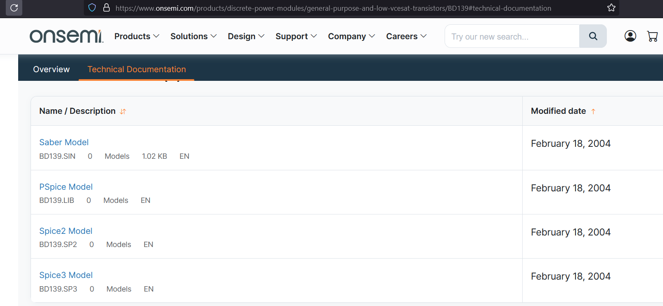
Additionally, many manufacturers offer Spice models.
http://www.onsemi.com/
Francesco Sacco
linkedin.com/in/saccofrancesco

